Slide 1
Cultural context of IHRM (continued)
Module 2

Slide 2
The GLOBE Study
GLOBE is an acronym for Global Leadership and Organizational Behavior Effectiveness
questions:
Are there leadership behaviors, attributes, and organizational practices that are generally accepted and effective across cultures? in some cultures only?
How much do leadership attributes that are traced back to social and organizational contexts affect the effectiveness of specific leadership behavior and its acceptance by subordinates?
How much do behaviors and attributes in specific cultures influence the economic, physical, and psychological well-being of the members of societies?

Slide 4
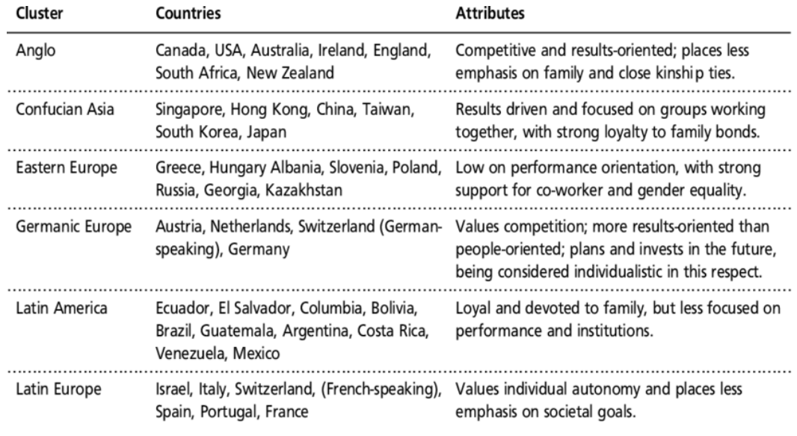

Slide 5
GLOBE Study – Optional Extra info
GLOBE Project Cultural Dimensions:
https://www.youtube.com/watch?v=3du_rZ0U90Q
What did GLOBE really measure?
https://core.ac.uk/download/pdf/6416293.pdf
Link to the project:
https://www.globeproject.com/

Slide 6
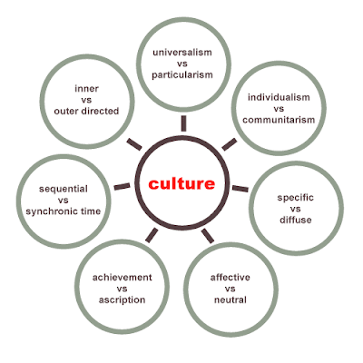
Trompenaars and Hampden-Turner study
They differentiated between seven dimensions, the characteristics of which mark the differences between cultures.
They grouped these seven dimensions by three aspects: relationships between people, concept of time and concept of nature

Slide 8
Relationships between people
Universalism vs. Particularism: Universalist thought is characterized by the following logic: “What is good and right can be defined and always applies”. Particularist cultures, on the contrary, pay more attention to individual cases, deciding what is good and correct depending on relationship and special friendship arrangements.
Individualism vs. Communitarianism: The underlying question is: “Do people regard themselves primarily as individuals or primarily as parts of a group?”. The other question is whether it is desirable that individuals primarily serve group aims or individual aims. Individualist cultures emphasize the individual, who predominantly takes care of himself. Alternately, communitarian cultures focus on identity, responsibility and concern that focus on a larger social group.

Slide 9
Relationships between people
Emotional vs. Neutral: Describes how emotions are treated and whether they are expressed or not. Neutral cultures tend to express little emotion; business is transacted as objectively and functionally as possible. In affective cultures, an emotional cultural basis is accepted as a part of business life and emotions are freely expressed across many social contexts.
Specific vs. diffuse: In diffuse cultures a person is involved in the business relationship, whereas specific cultures focus more on contractually regulated aspects. Specific cultures demand precision, an objective analysis of circumstances and presentation of results, whereas diffuse cultures take other context variables into consideration.

Slide 10
Relationships between people
Ascription vs. Achievement: In cultures focused on status achievement, people are judged based on what they have achieved; in other words, the goals they have fulfilled recently. In ascriptive cultures, the status is ascribed from birth by characteristics such as origin, seniority, and gender.

Slide 11
Concept of time and Concept of Nature
Sequential vs. Synchronic concept of time: Cultures may be more past-, future- or present-oriented. It is also demonstrated by the organization of work processes. Sequential behavior is behavior that occurs successively, and synchronous behavior is the possibility to ‘multitask’ and do a number of things at the same time.
Internal vs. external control: Refers to the extent to which societies try to control nature. Example is wearing a facemask during the cold/flu season. In external control cultures, masks are used because one does not want to infect others, whereas in internal control cultures masks are used to protect one’s self from outside sources of infection.

Slide 12
Hall Cultural Dimensions
High vs. Low Context Communication: Cultures differ in the way their members communicate with each other. In high context cultures, a more indirect form of expression is common, where the receiver must decipher the content of the message from its context, whereas in so-called low context cultures the players tend to communicate more to the point and verbalize all-important information. Examples of high context cultures are Japan as well as France. Germany is more of a low context culture.
Spatial orientation: The focus of this dimension is on the distance between people of various cultures when communicating. Distance that is adequate for members of one culture may feel intrusive for members of another culture.
Monochrome vs. polychrome concept of time: A monochrome concept of time is dominated by processes where one thing is done after the other, whereas in the polychrome concept these actions occur at the same time.
Information speed: This dimension focuses on whether information flow in groups is high or low during communication. Thus, in the USA, people tend to exchange personal information relatively quickly, while in Europe such a rate of information exchange would require a more extended acquaintance.

Slide 14
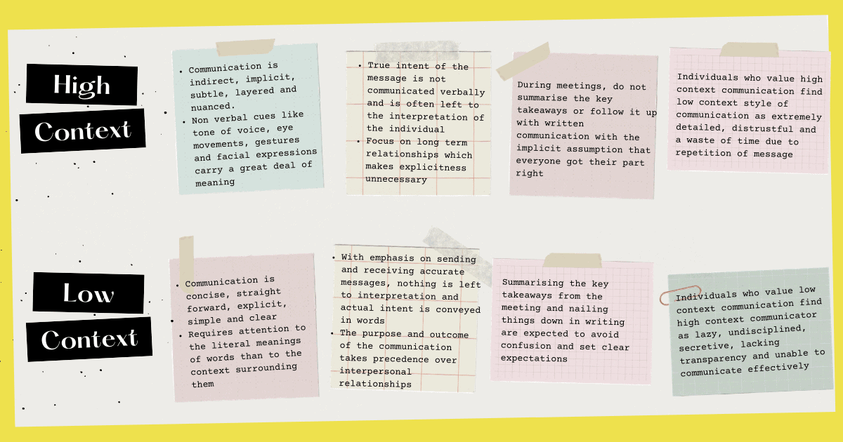

Slide 15
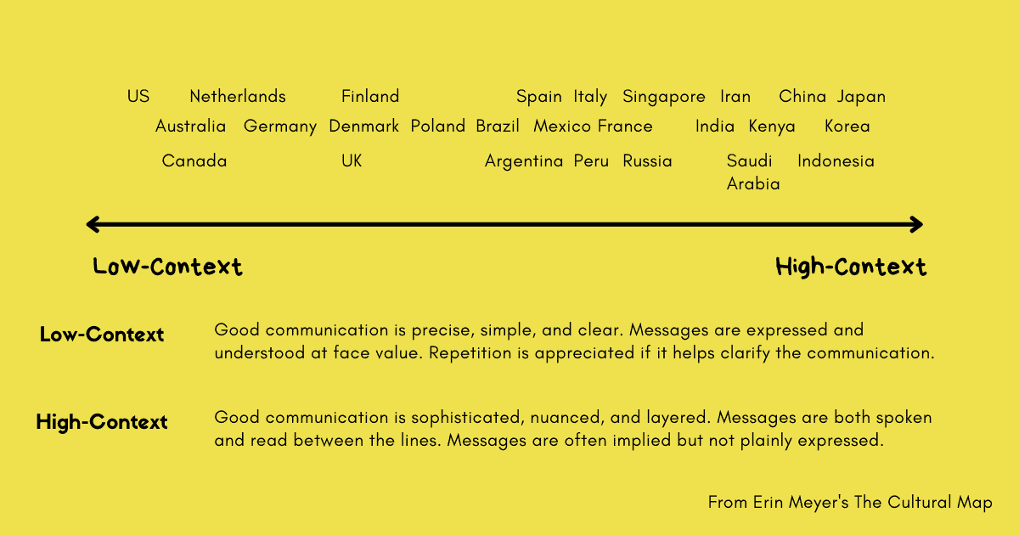

Slide 16
Erin Myer’s Culture Map
Professor at INSEAD
Questionnaire https://hbr.org/2014/08/whats-your-cultural-profile
Article https://hbr.org/2014/05/navigating-the-cultural-minefield

Slide 17
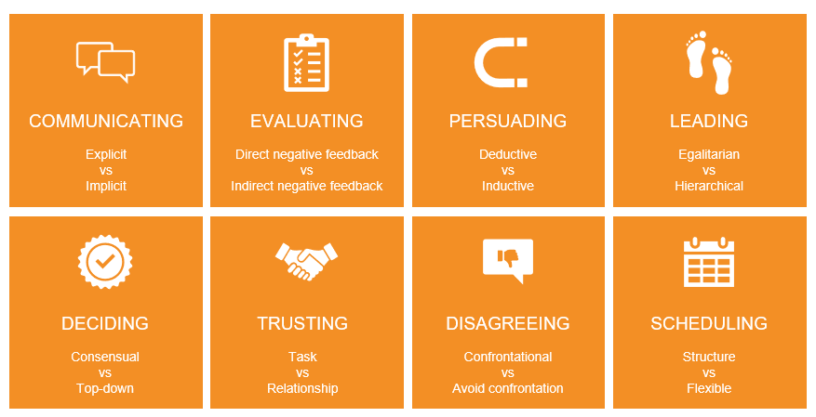

Slide 18
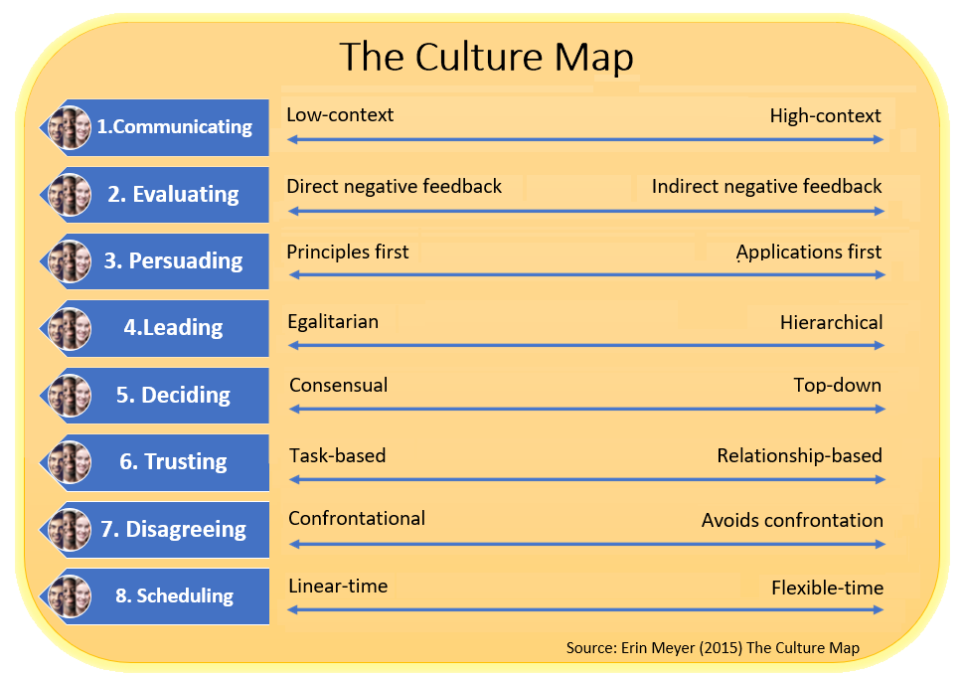

Slide 19
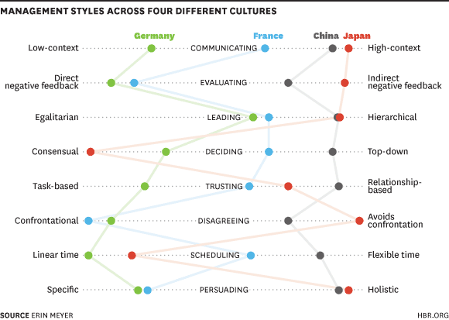

Slide 21
Development of cultures
Cultures undergo changes over time
Cultural convergence and divergence
Macro level and micro level
Value shift between generations
Globalization process
Professional cultures
Notes:
Cultures are not static but rather they are constantly evolving and changing over time. Cultural changes can occur due to various factors, such as technology, migration, social movements, and globalization.
One of the ways cultures change is through cultural convergence and divergence. Cultural convergence refers to the blending of cultures due to increased interaction and exchange between them, while cultural divergence refers to the preservation of distinct cultural practices and traditions.
Cultural changes can also occur at both macro and micro levels. Macro-level changes refer to changes that affect the entire society, while micro-level changes refer to changes that occur within smaller groups or communities.
Value shifts between generations is another important factor in cultural change. As younger generations come of age, they often have different values and beliefs than their parents or grandparents, leading to cultural shifts over time.
Globalization has also had a profound impact on cultural change, as it has led to increased cultural exchange and blending across the world. However, it has also led to concerns about the loss of cultural diversity and the homogenization of culture.
Finally, professional cultures can also undergo changes over time, as new technologies, practices, and norms emerge within a particular field or industry. As professionals adapt to these changes, they may develop new ways of thinking and behaving, leading to cultural changes within their organizations or professions.

Slide 22
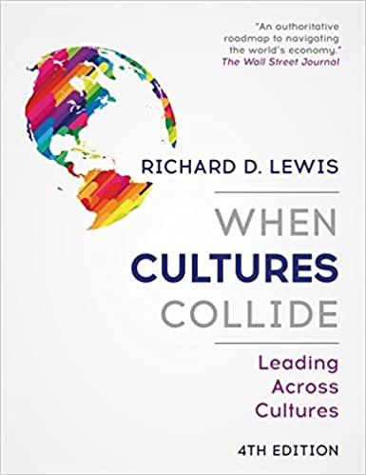
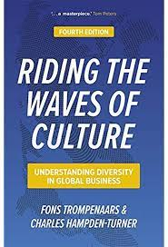

Slide 23
Summary
We learned how cultural environment may influence HRM
We are able to compare various cultural studies
We understand the convergence and divergence of HRM and work practices.

Slide 24
Organizational context of IHRM
Module 3

Slide 25
Module 3 objectives
We examine how international growth places demands on management, and the factors that impact how managers respond to these challenges.
HR activities are influenced by organizational factors.
We discuss the following aspects:
issues of standardization and localization
structural responses to international growth
control and coordination mechanisms
effect of responses on HRM approaches and activities

Slide 26
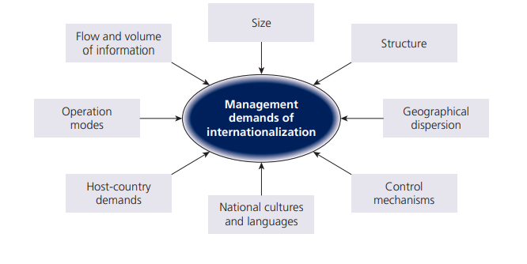
Management demands

Slide 27
Internationalization strategy
Internationalization strategy refers to the plan and approach a company takes to expand its operations beyond its home country's borders.
An effective internationalization strategy requires a comprehensive understanding of the external and internal factors that affect the company's ability to operate successfully in foreign markets, including economic, political, cultural, and legal factors.

Slide 30
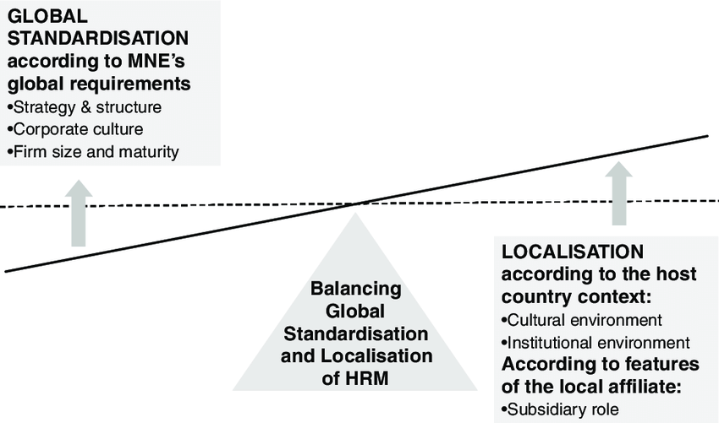

Slide 31
Impact of internationalization strategy on IHRM practices
Globalization approach
Localization approach
Consistent HR practices across all its international operations
Standardized HR policies and practices, such as performance management, compensation, and benefits, that are consistent across all markets.
HR practices that are tailored to each local market.
Adapting HR policies and practices to fit local cultural and legal contexts, such as recruitment and selection practices that consider local labor laws, cultural norms, and language requirements.

Slide 32
FACTORS DRIVING LOCALIZATION
The cultural environment: cultures where work is based on social relationships may value a more complete balance of intrinsic and extrinsic rewards, while cultures characterized by personal independence (‘individualism’), as well as rapidly changing personal and social contexts, may emphasize extrinsic rewards.
The institutional environment: institutional norms and values may be based on the features of a national business system(education system, legal system, tax system, exchange rates, social welfare system, labour unions, etc).

Slide 33
Organizational structure
Organizational structure refers to the way an organization arranges its lines of authority, communications, and roles to achieve its goals.
The structure of an organization has a significant impact on IHRM practices, as it affects the way employees work together and the decision-making process within the organization.
More reading here: https://creately.com/blog/diagrams/types-of-organizational-charts/

Slide 35
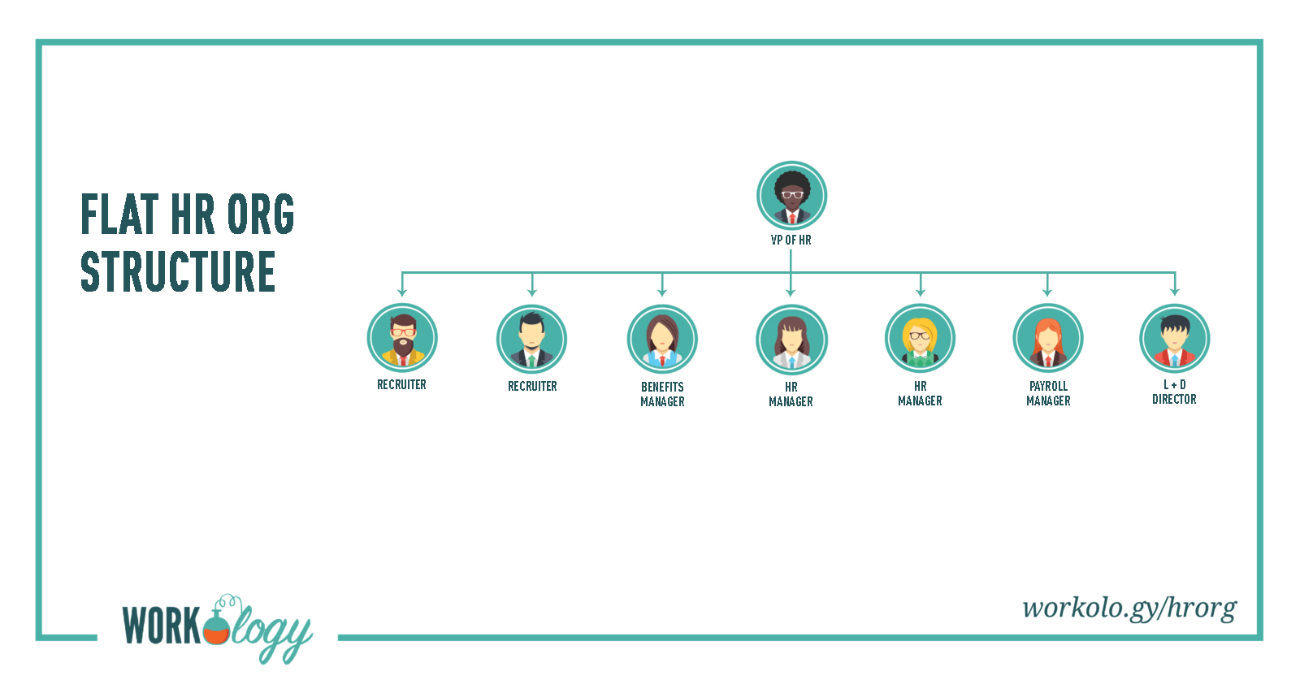

Slide 36
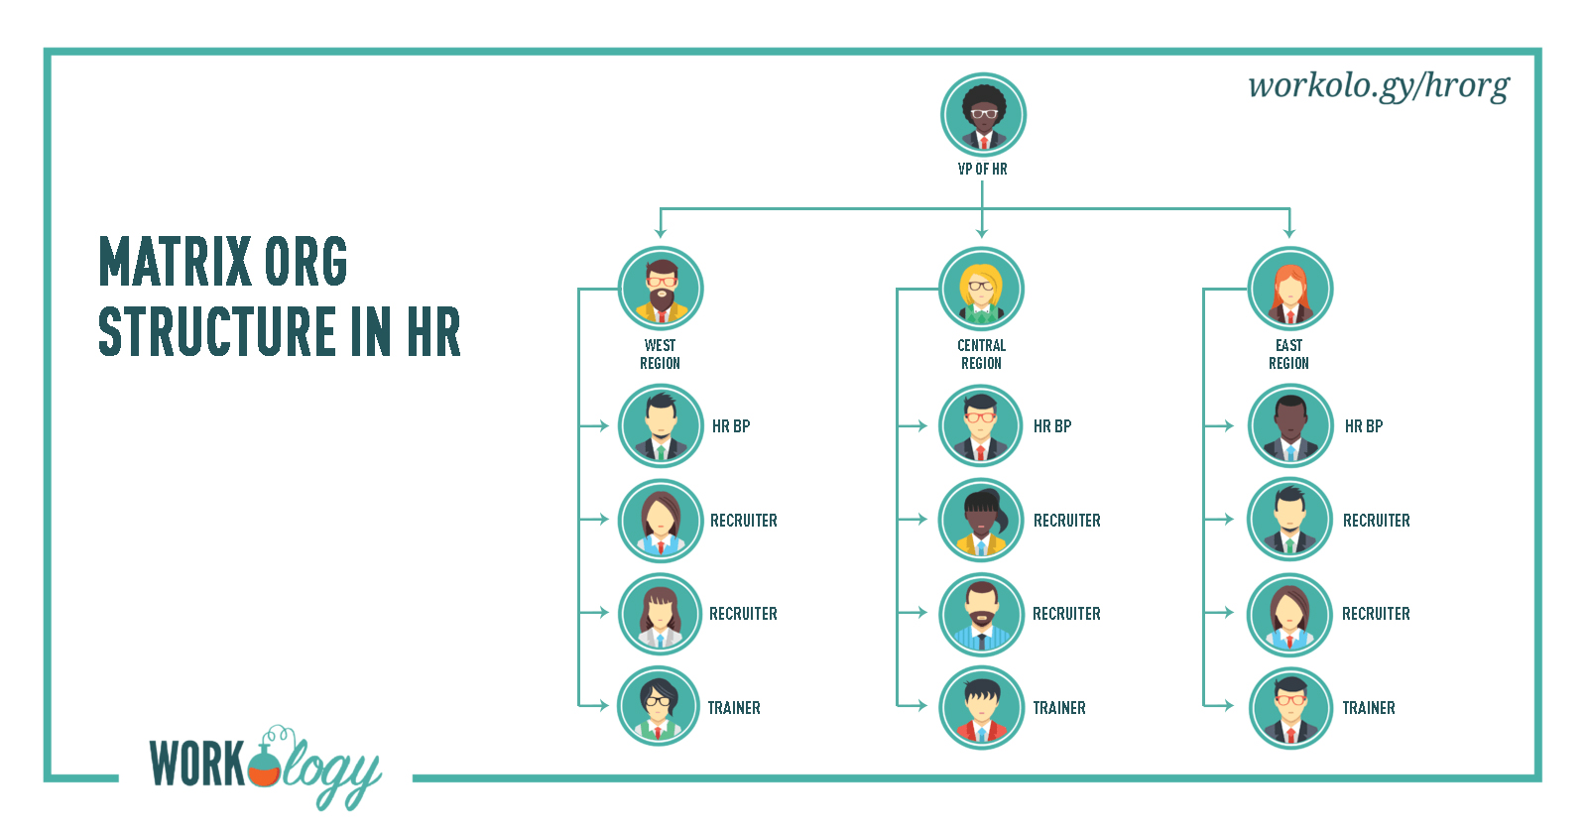

Slide 37
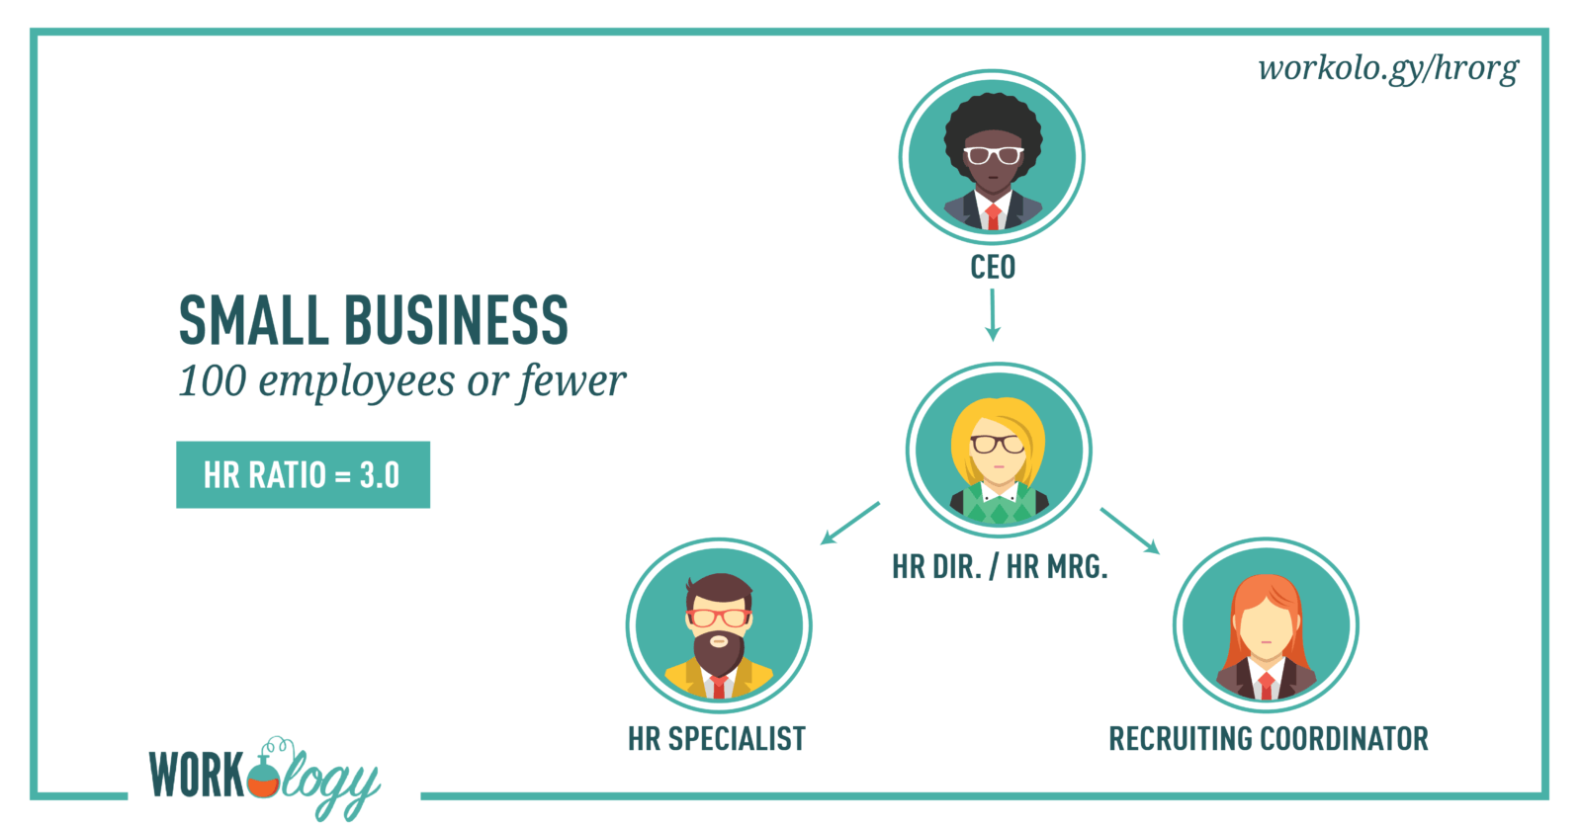

Slide 38
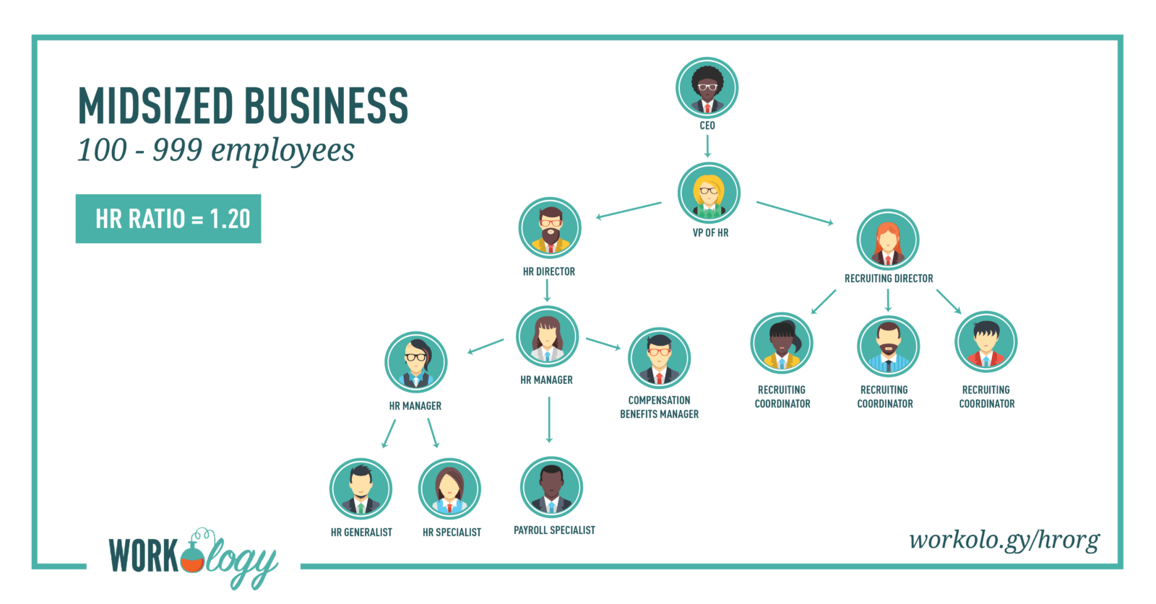

Slide 39
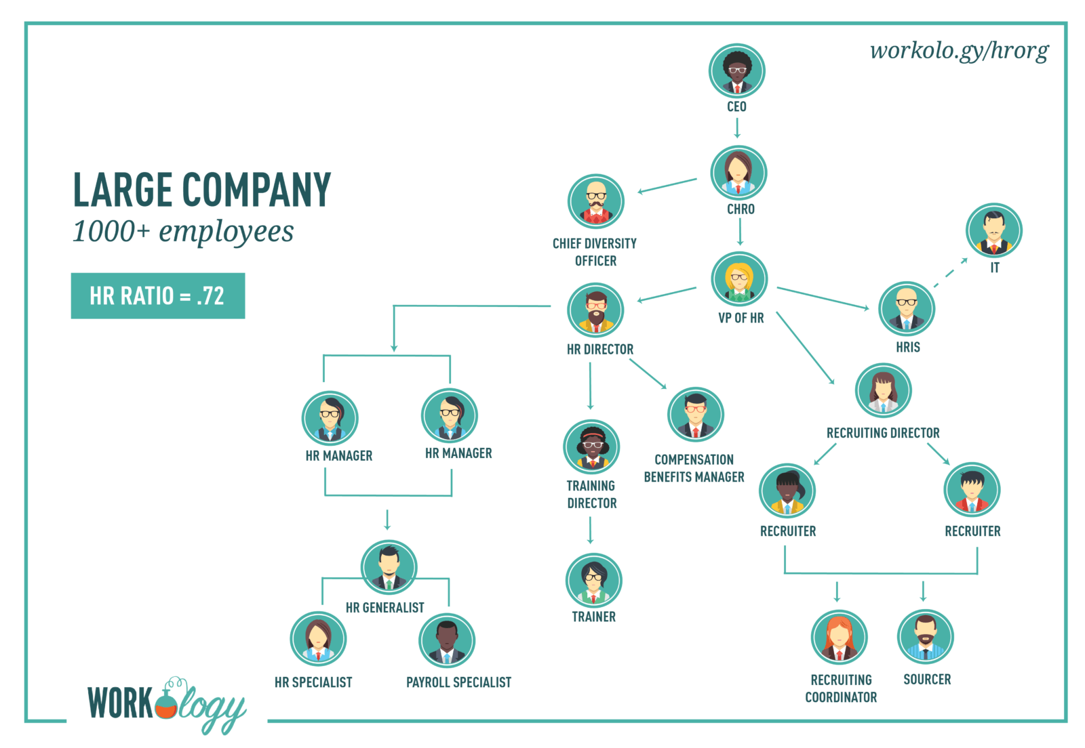

Slide 40
How Many People Should Work in Your HR Department?
The size of an organization and it’s a commitment to its culture and people largely determine the organizational structure of HR, not to mention geography and leadership.
Companies can use an HR to employee ratio as a guide to determining if more HR support needs to be added to the department.
On a basic level, the HR to staff ratio is the number of employees/HR team members.

Slide 41
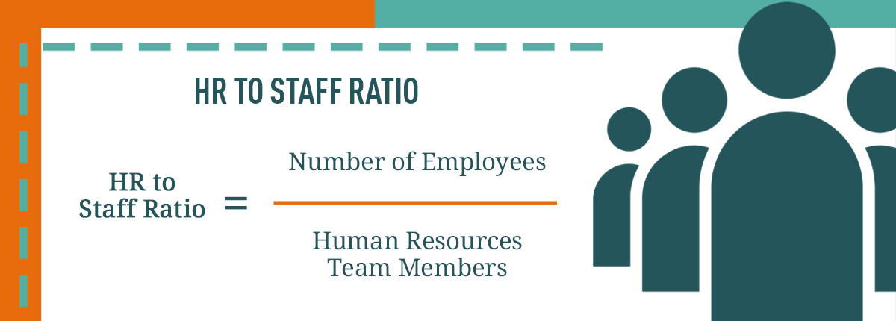
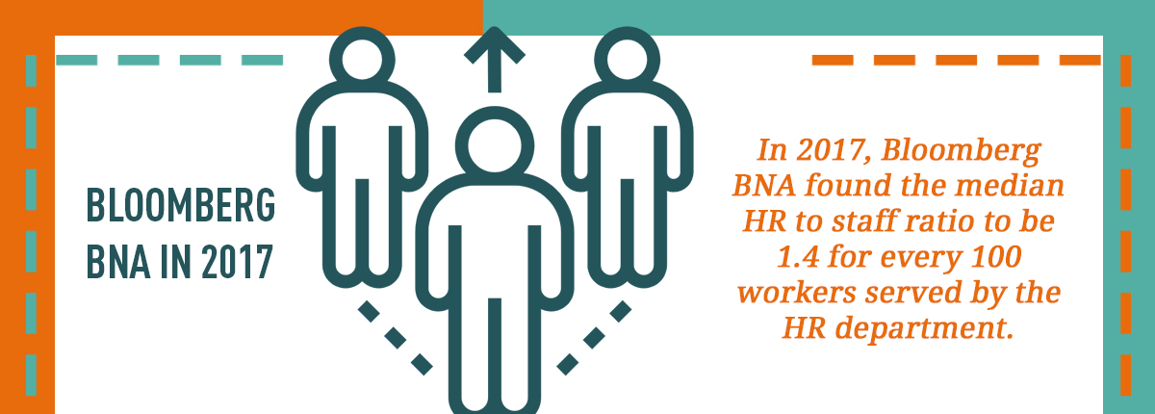

Slide 42
Watch additional videos (optional):
Business Speaker Erin Meyer:
https://www.youtube.com/watch?v=9oYfhTC9lIQ
https://www.youtube.com/watch?v=zQvqDv4vbEg
https://www.youtube.com/watch?v=IwBPfbEeynw
https://www.youtube.com/watch?v=Q3X7legs3gM
Edgar Schein's Culture Model:
https://www.youtube.com/watch?v=HM89E6ltVOg
Trompenaars 7 Cultural Dimensions:
https://www.youtube.com/watch?v=NFVMhfifZco
PEST Analysis (PESTLE):
https://www.youtube.com/watch?v=7qrahnx94nc

