Slide 1
Control and coordination mechanisms used in IHRM
Standardization: Standardization refers to the use of a common set of HR practices across all the locations of the organization. This ensures consistency in HR practices, which is particularly important in multinational companies. For example, a company may establish a global policy on compensation and benefits that applies to all employees, regardless of their location.
Centralization: Centralization refers to the consolidation of decision-making authority at the head office of the organization. This approach is useful in managing HR practices in a centralized manner, particularly in the case of global policies that are applied across all locations. In this approach, local HR managers are responsible for executing global HR policies in their respective locations.

Slide 2
Control and coordination mechanisms used in IHRM
Localization: Localization refers to the adaptation of HR practices to meet local needs and cultural differences. This approach recognizes that different countries and regions have unique cultural and legal requirements that need to be addressed. In this approach, local HR managers have more autonomy in designing and implementing HR practices, as they have a better understanding of the local context.
Hybrid: Hybrid approaches combine elements of standardization, centralization, and localization. For example, a company may have a global policy on compensation and benefits that applies to all employees but allows local HR managers to adapt it to meet local legal and cultural requirements.

Slide 3
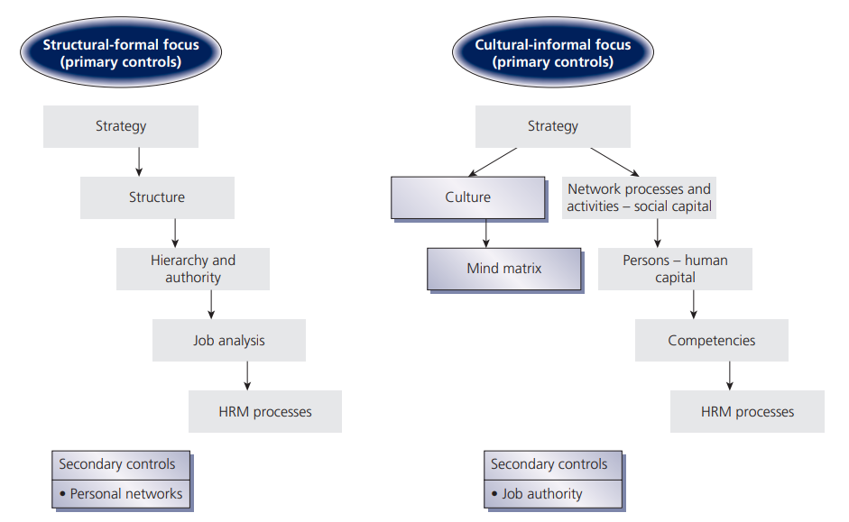
Control Strategies for Multinational Firms

Slide 4
Notes:
The McKinsey 7S model is a framework for organizational effectiveness and change management. It was developed by Tom Peters and Robert Waterman, consultants at McKinsey & Company, in the 1980s. The model is based on the idea that there are seven internal elements of an organization that need to be aligned and mutually reinforcing in order for the organization to be successful.
The McKinsey 7S model is used by organizations to diagnose problems and identify opportunities for improvement. By analyzing the seven elements of the model, organizations can identify areas of misalignment and take steps to improve their performance. The model is also used to guide organizational change, as it provides a framework for understanding how changes to one element of the organization can affect the others.

Slide 5
McKinsey’s 7S Design Model
Advantages of the 7s Model
Disadvantages of the 7s Model
balances the critical elements instead of focusing only on strategy and structure.
beneficial during mergers and acquisitions to bring functional elements and processes together.
You can use the model to develop analytics to measure the impact of changes.
does not include an action plan for change management. It is a static analysis of the balance of all the organizational elements.
The model doesn’t explicitly explain organizational effectiveness or performance.

Slide 6
McKinsey 7S model
This is a strategic management framework developed by McKinsey & Company in the 1980s. It helps organizations to analyze and align their internal factors in order to achieve their strategic goals.
The model suggests that all seven elements are interconnected, and that changes in one element will have an impact on the others. For example, a change in strategy may require a change in structure or systems to support it.
The model can be used to diagnose an organization's current situation, identify areas for improvement, and develop a plan to implement changes that will improve alignment and achieve strategic goals.

Slide 7
Case study: XYZ Corporation
XYZ Corporation is a Ukrainian outsourcing software development company that is in business for 10 years and has 50 employees.
The company specializes in developing custom software solutions for clients in various industries.
Despite its success, the company has been experiencing employee turnover and low morale among its staff.
The CEO has hired your HR consulting firm to help diagnose and address the problem. Your team has been tasked with analyzing XYZ Corporation's HR practices and making recommendations for improvement.

Slide 8
Analyze XYZ Corporation's HR practices and identify areas for improvement.
Strategy: What is XYZ Corporation's HR strategy? Does it align with the company's overall strategy? If not, how can it be improved?
Structure: What is the HR organizational structure at XYZ Corporation? Is it effective in supporting the company's goals and objectives?
Systems: What HR systems are in place at XYZ Corporation? Are they effective in supporting HR operations? If not, how can they be improved?
Shared values: What are the company's HR values and beliefs? Are they aligned with the company's overall culture and values? If not, how can they be improved?

Slide 9
Analyze XYZ Corporation's HR practices and identify areas for improvement.
Skills: What are the HR skills and competencies required at XYZ Corporation? Does the company have the necessary talent in place to support its HR operations? If not, how can it be improved?
Style: What is the leadership and management style in the HR department at XYZ Corporation? Does it align with the company's overall style? If not, how can it be improved?
Staff: What is the current HR staff profile at XYZ Corporation? Are they the right people for the job? If not, how can it be improved?

Slide 10
Notes:
Jay Galbraith's Star Model is a framework for organizational design that helps organizations align their structure, processes, rewards, and people with their strategy. It was first introduced in the 1970s and has been widely adopted by many organizations since then.

Slide 11
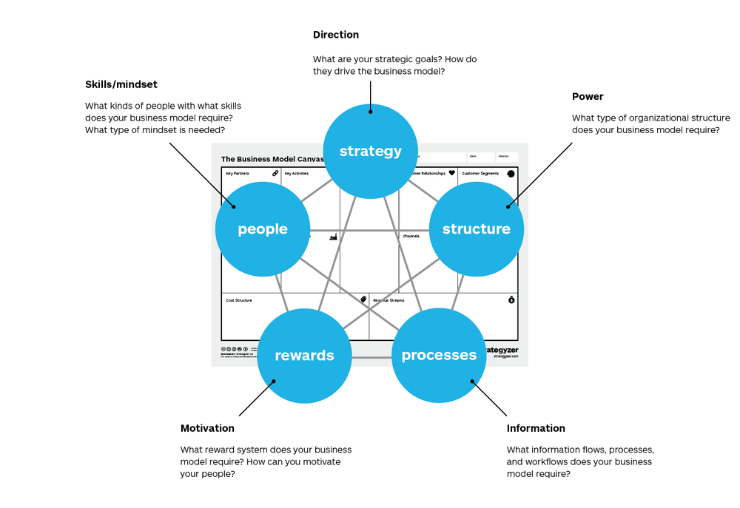

Slide 12
Jay Galbraith’s Star Model
The Star Model is a framework for influencing employee behavior through a “series of design policies” controllable by management:
Strategy determines goals and objectives, values and missions, and the “basic direction of the company.”
Structure determines where power and authority lie.
Processes are the flow of information and decision processes across the organizational structure.
Rewards align employee goals to organizational goals.
People refers to aligning human resources policies and functions to develop both people and organizational capabilities.
Notes:
By aligning these five elements, organizations can create a high-performance culture that supports their strategy and goals. The Star Model provides a holistic framework for designing organizations that are effective and efficient, and it can be used to diagnose problems and identify opportunities for improvement.

Slide 13
Homework - Jay Galbraith's Star Model
Choose a multinational company that operates in more than one country. Analyze the company using the Jay Galbraith's Star Model. Identify the following elements:
Strategy: What is the company's strategy for operating in different countries? How does it approach issues such as localization, standardization, and adaptation?
Structure: How is the company structured to manage its international operations? How are decisions made and communicated across different locations?
Processes: What HRM processes does the company use to manage its international operations? How are these processes aligned with the company's strategy and structure?
Rewards: What rewards and incentives does the company offer to employees in its international operations? How are these rewards and incentives aligned with the company's strategy and goals?
People: What skills and competencies are required to manage international HRM in the company? How does the company ensure that its employees have the necessary skills and competencies?
Based on your analysis, identify at least two strengths and two weaknesses in the company's international HRM practices using the Star Model. Make sure your strengths and weaknesses are specific and aligned with the elements of the model. Write a brief report (300-500 words) summarizing your analysis.

Slide 14
Watch additional videos (optional):
Star Model Explained:
https://www.youtube.com/watch?v=9UENqPifrgM
McKinsey 7S Framework Explained
https://www.youtube.com/watch?v=DFNJypMOIMI
The Organization Design Toolkit for HR
https://www.youtube.com/watch?v=6P0hw3Q1imI
Read: Designing Strategic Organizations: The New Work of Executives and HR
https://kateskesler.com/wp-content/uploads/2012/08/HRPS_PeopStrat33_3_KatesKesler.pdf

Slide 15
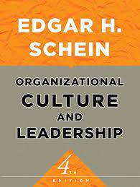
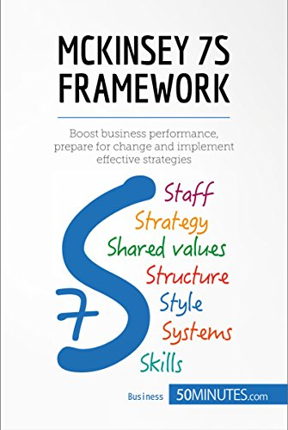
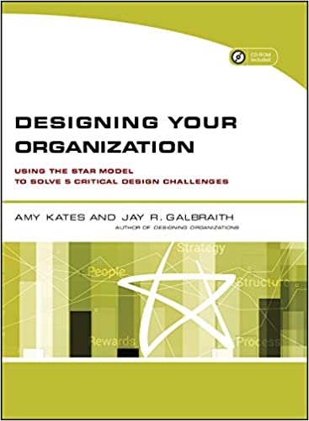

Slide 16
Summary
We learnt the concept of internationalization strategy
We looked at organizational structures
We discussed control and coordination mechanisms used in IHRM
We reviewed McKinsey 7s framework and Galbraith's Star Model

Slide 17
International Recruitment, Selection and Talent Management
Module 4

Slide 18
Learning outcomes:
Understand the key processes associated with attracting, recruiting, selecting and retraining talent
Gain a deeper understanding of employer branding
Identify and make informed decisions regarding this topic
Understand talent management

Slide 19
What is talent?
Talent refers to individuals who have exceptional abilities or potential in their respective fields or job roles.
Talent refers to the skills, knowledge, and abilities of employees that enable them to contribute to the success of the organization.
Talent is the collective set of skills, abilities, and potential that an organization seeks to attract, develop, and retain in order to achieve its strategic objectives.
Talent is the unique combination of personality traits, cognitive abilities, and specialized knowledge and skills that individuals possess, and that are relevant to their job roles within the organization.
Talent is the key resource that organizations must effectively manage and leverage in order to achieve sustainable competitive advantage in the marketplace.
Talent refers to the individuals who possess the capabilities, potential, and motivation to drive innovation, creativity, and high performance within the organization.

Slide 20
Exclusive and Inclusive approaches
Exclusive approach: This approach focuses on identifying and developing a select group of employees who are deemed to have the highest potential or talent within the organization. It often involves offering these employees special opportunities, rewards, and benefits that are not available to others, such as exclusive training programs or higher pay.
Inclusive approach: This approach focuses on developing the talent and potential of all employees within the organization, regardless of their job role or level of seniority. It involves providing opportunities for learning and development, as well as recognition and rewards, to all employees.

Slide 21
Talent management
Talent management is the systematic process of attracting, developing, retaining, and leveraging the skills, knowledge, and abilities of employees to achieve organizational goals.
It involves identifying key talent within an organization, providing opportunities for development and growth, and aligning talent with the needs of the organization.
Talent management encompasses a range of activities including recruiting, onboarding, performance management, career development, and succession planning.
It is a critical function for organizations seeking to build a high-performance workforce and achieve long-term success.

Slide 23
Talent management
Strategy, culture and structure
Employer brand
Diagnosing and planning
Acquiring and selecting
Managing
Developing and retraining

Slide 24
Employer brand
Employer brand refers to an organization's reputation and identity as an employer, which includes its values, culture, work environment, employee benefits, and other factors that affect how the organization is perceived by current and potential employees.
It is the overall image that an organization projects to the public as a place to work and is a key factor in attracting and retaining talent.
A strong employer brand can help attract and retain top talent, as well as enhance the organization's reputation and competitiveness in the marketplace.
A weak or negative employer brand can make it difficult for an organization to attract and retain talent.

Slide 25
Fortune's top 10 'Best Companies to Work For' in 2023
Cisco Systems
Hilton
American Express
Wegmans Food Markets
Accenture
Nvidia
Atlassian
Salesforce
Comcast
Marriott International

Slide 26
Homework
Identify three companies you would like to work for based on their employer brand and why?
Write two-three sentences about each of the three companies you selected (300-500 words max).

Slide 27
Homework (Optional)
Optional reading re talent management:
https://www.gartner.com/smarterwithgartner/use-a-digital-talent-management-framework-to-future-proof-the-it-workforce
https://www.aihr.com/blog/talent-management-framework/
Optional reading re employer brand:
https://www.aihr.com/blog/employer-branding-examples/
https://www.aihr.com/blog/employer-branding-metrics/
https://www.aihr.com/blog/employer-branding-strategy/

