Slide 1
International Recruitment, Selection and Talent Management
Module 4

Slide 2
Learning outcomes:
Understand the key processes associated with attracting, recruiting, selecting and retraining talent
Gain a deeper understanding of employer branding
Identify and make informed decisions regarding this topic
Understand talent management

Slide 3
What is talent?
Talent refers to individuals who have exceptional abilities or potential in their respective fields or job roles.
Talent refers to the skills, knowledge, and abilities of employees that enable them to contribute to the success of the organization.
Talent is the collective set of skills, abilities, and potential that an organization seeks to attract, develop, and retain in order to achieve its strategic objectives.
Talent is the unique combination of personality traits, cognitive abilities, and specialized knowledge and skills that individuals possess, and that are relevant to their job roles within the organization.
Talent is the key resource that organizations must effectively manage and leverage in order to achieve sustainable competitive advantage in the marketplace.
Talent refers to the individuals who possess the capabilities, potential, and motivation to drive innovation, creativity, and high performance within the organization.

Slide 4
Exclusive and Inclusive approaches
Exclusive approach: This approach focuses on identifying and developing a select group of employees who are deemed to have the highest potential or talent within the organization. It often involves offering these employees special opportunities, rewards, and benefits that are not available to others, such as exclusive training programs or higher pay.
Inclusive approach: This approach focuses on developing the talent and potential of all employees within the organization, regardless of their job role or level of seniority. It involves providing opportunities for learning and development, as well as recognition and rewards, to all employees.

Slide 5
Talent management
Talent management is the systematic process of attracting, developing, retaining, and leveraging the skills, knowledge, and abilities of employees to achieve organizational goals.
It involves identifying key talent within an organization, providing opportunities for development and growth, and aligning talent with the needs of the organization.
Talent management encompasses a range of activities including recruiting, onboarding, performance management, career development, and succession planning.
It is a critical function for organizations seeking to build a high-performance workforce and achieve long-term success.

Slide 7
Talent management
Strategy, culture and structure
Employer brand
Diagnosing and planning
Acquiring and selecting
Managing
Developing and retraining

Slide 8
Employer brand
Employer brand refers to an organization's reputation and identity as an employer, which includes its values, culture, work environment, employee benefits, and other factors that affect how the organization is perceived by current and potential employees.
It is the overall image that an organization projects to the public as a place to work and is a key factor in attracting and retaining talent.
A strong employer brand can help attract and retain top talent, as well as enhance the organization's reputation and competitiveness in the marketplace.
A weak or negative employer brand can make it difficult for an organization to attract and retain talent.

Slide 9
Fortune's top 10 'Best Companies to Work For' in 2023
Cisco Systems
Hilton
American Express
Wegmans Food Markets
Accenture
Nvidia
Atlassian
Salesforce
Comcast
Marriott International

Slide 10
Discussion
Identify three companies you would like to work for based on their employer brand and why?

Slide 11
What is EVP?
EVP stands for Employee Value Proposition.
It is a set of unique offerings and benefits that an organization provides to its employees in exchange for their skills, knowledge, and contributions.
By defining and communicating a compelling EVP, an organization can differentiate itself from its competitors and become an employer of choice.

Slide 12
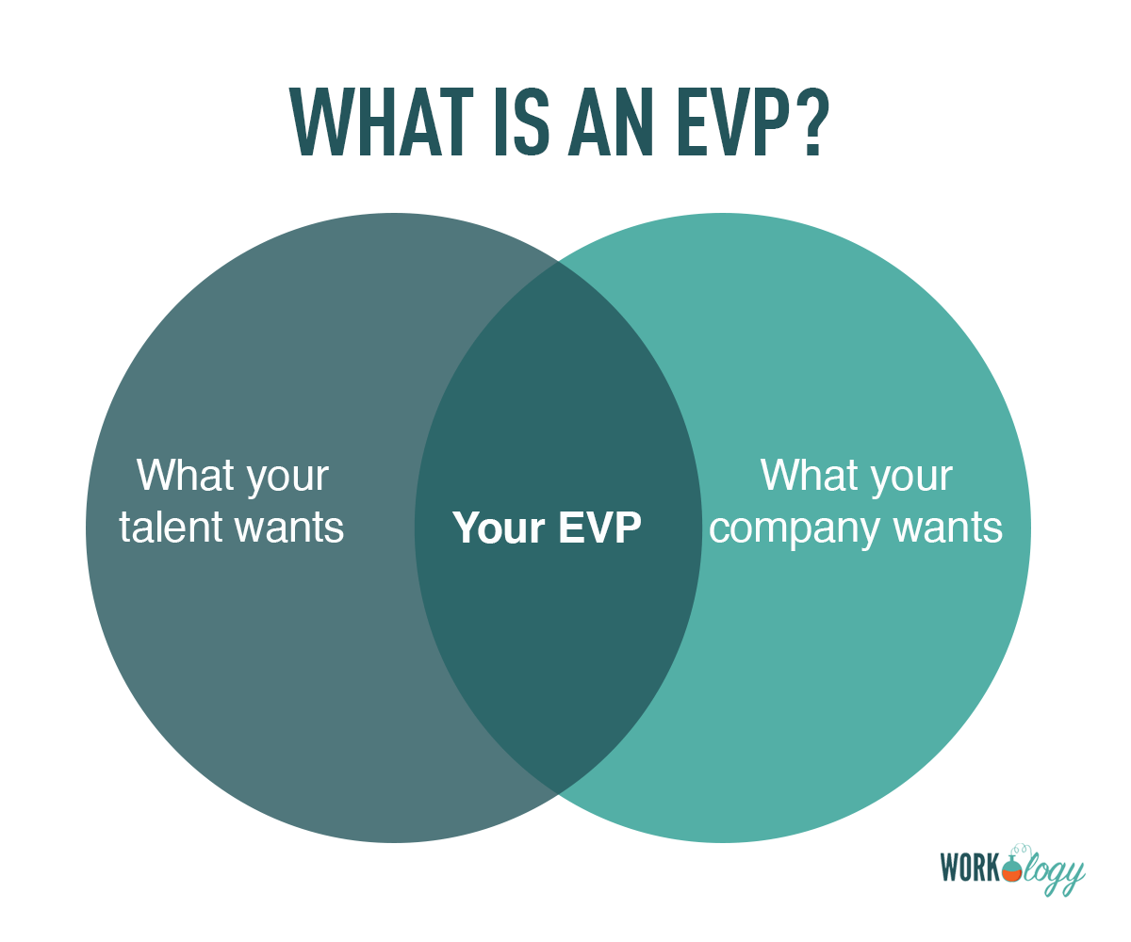

Slide 13
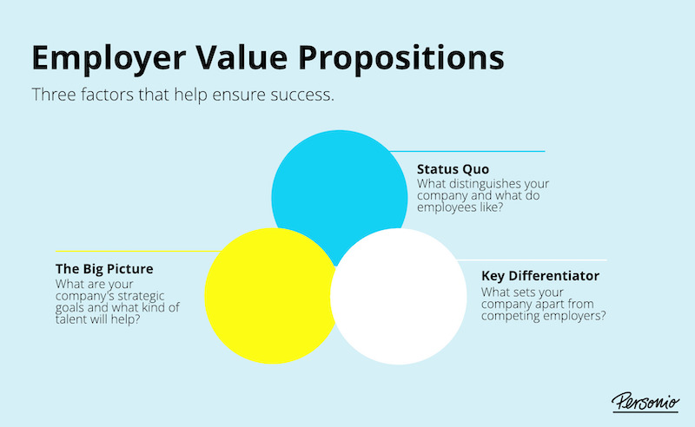

Slide 14
Examples of Employee Value Proposition (EVP)
Competitive compensation
Comprehensive benefits
Flexible work arrangements
Career development opportunities
Company culture and values
Recognition and rewards
Work environment and facilities

Slide 15
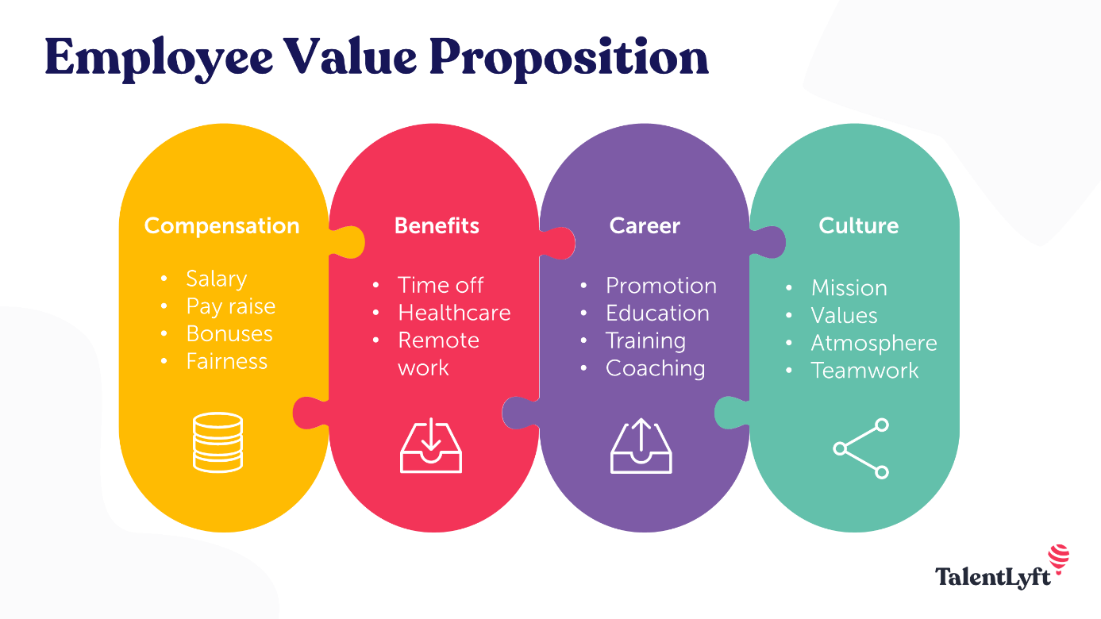

Slide 16
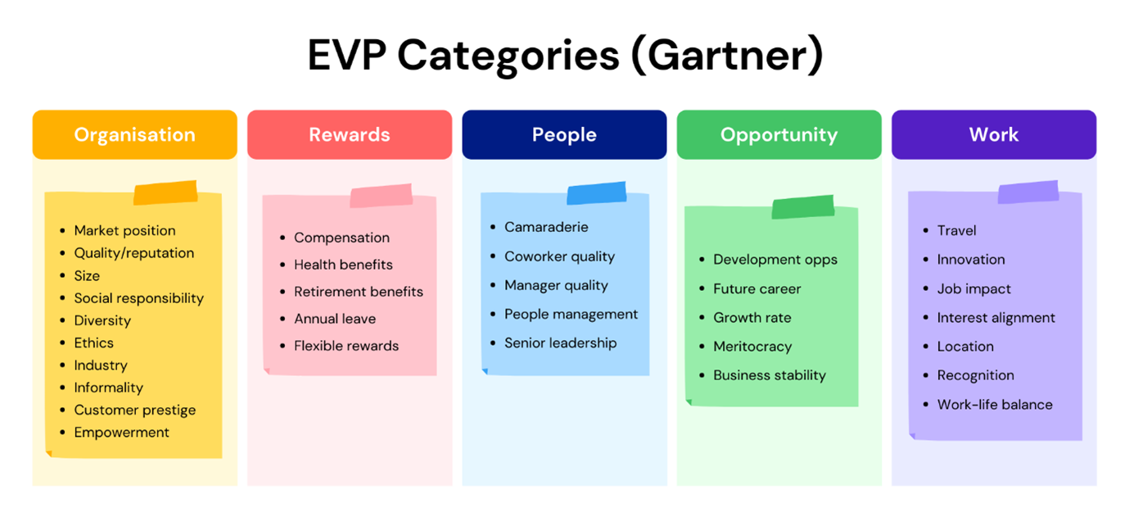

Slide 17
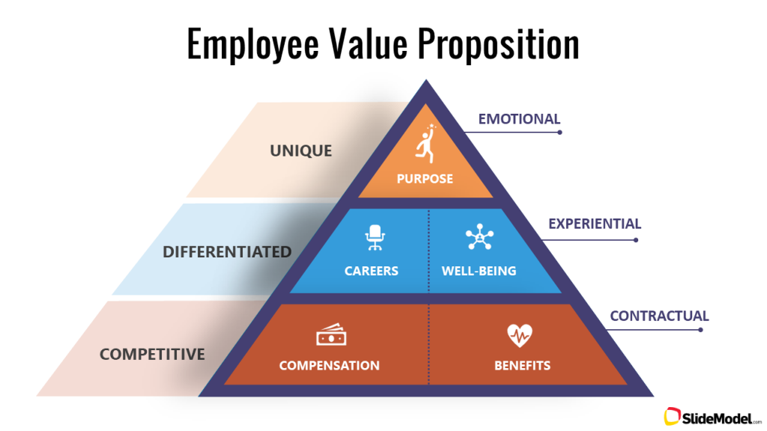

Slide 18
Examples of EVP
EVP for Apple:
"At Apple, we believe in hiring the best and brightest talent from around the world. We offer competitive compensation packages and a comprehensive benefits package, including health and wellness benefits, retirement savings, and education assistance. We also provide opportunities for career growth and development, a diverse and inclusive workplace, and a culture of innovation and creativity. At Apple, you will work with some of the most talented people in the industry and make a meaningful impact on the world through our products and services."
EVP for Google:
"At Google, we are committed to creating a culture that fosters creativity, collaboration, and innovation. We offer a comprehensive benefits package, including health and wellness benefits, retirement savings, and education assistance. We also provide opportunities for professional growth and development, including internal training programs, leadership development, and mentorship. We value diversity and inclusion and strive to create an environment where everyone feels valued and supported. At Google, you will work with some of the brightest minds in the industry and have the opportunity to make a positive impact on the world through our technology."

Slide 19
Brand Archetypes
A brand archetype is a personification of your brand in its most basic form. It's an archetype: a template that can be applied across different scenarios and contexts.
You might have heard about archetypes before and how they're used in storytelling; for example, every hero has certain traits that make them heroic (e.g., courage, strength, etc). Therefore, you should think of the qualities of a hero that will resonate with your target audience and integrate those into your brand identity.

Slide 20
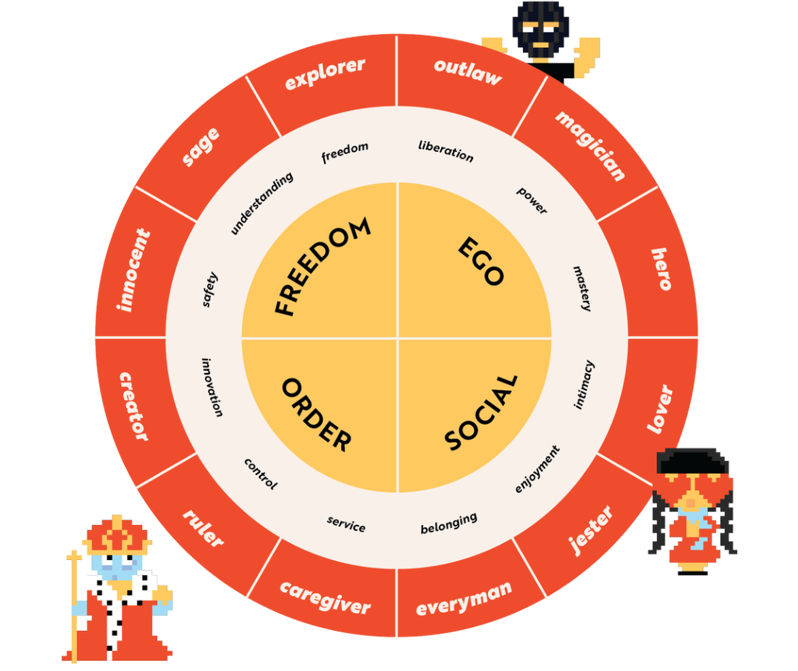

Slide 21
Brand Archetypes
The Innocent is happy and easygoing, won’t try to manipulate you, but may attempt to pull at your heartstrings.
The Everyman wants to belong and feel like part of a community.
The Hero has something to prove, and it’s usually about being the best.
The Outlaw has no fear and, like a true rebel, will buck the status quo and then laugh about it.
The Explorer wants freedom and little else.
The Creator is always pushing production to the extreme, in pursuit of perfection.
The Ruler wants to live like royalty, and prioritizes luxury and indulgence.
The Magician makes dreams come true.
The Lover will entice and seduce you, often with the lure of decadent treasures.
The Caregiver is warm and nurturing, and is mostly concerned with earning your trust.
The Jester wants to make everyone laugh with their silly, off-the-wall approach to the world.
The Sage is always seeking truth, and puts pursuit of knowledge above all else.

Slide 22
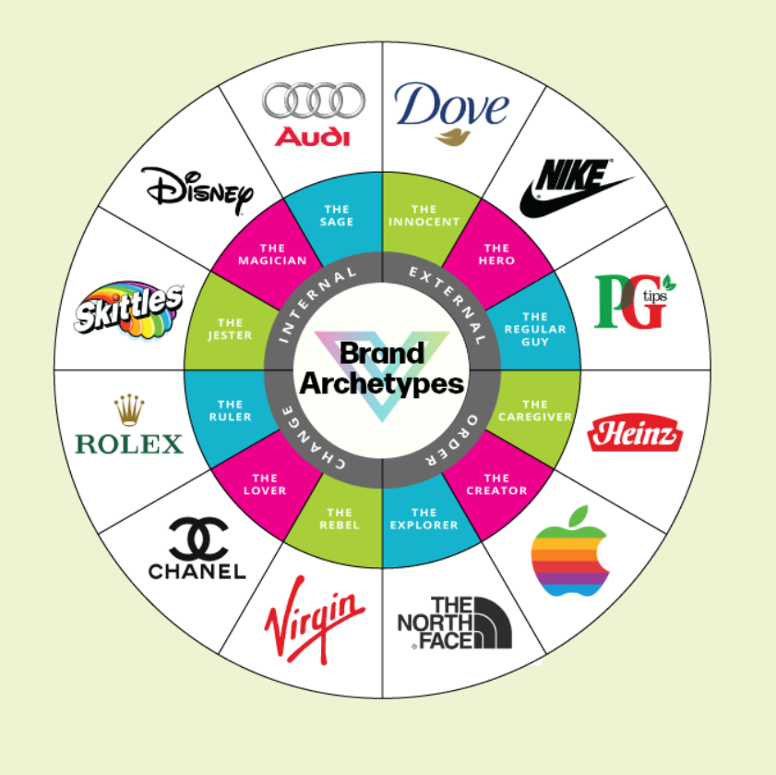
Examples of Brand Archetypes

Slide 23
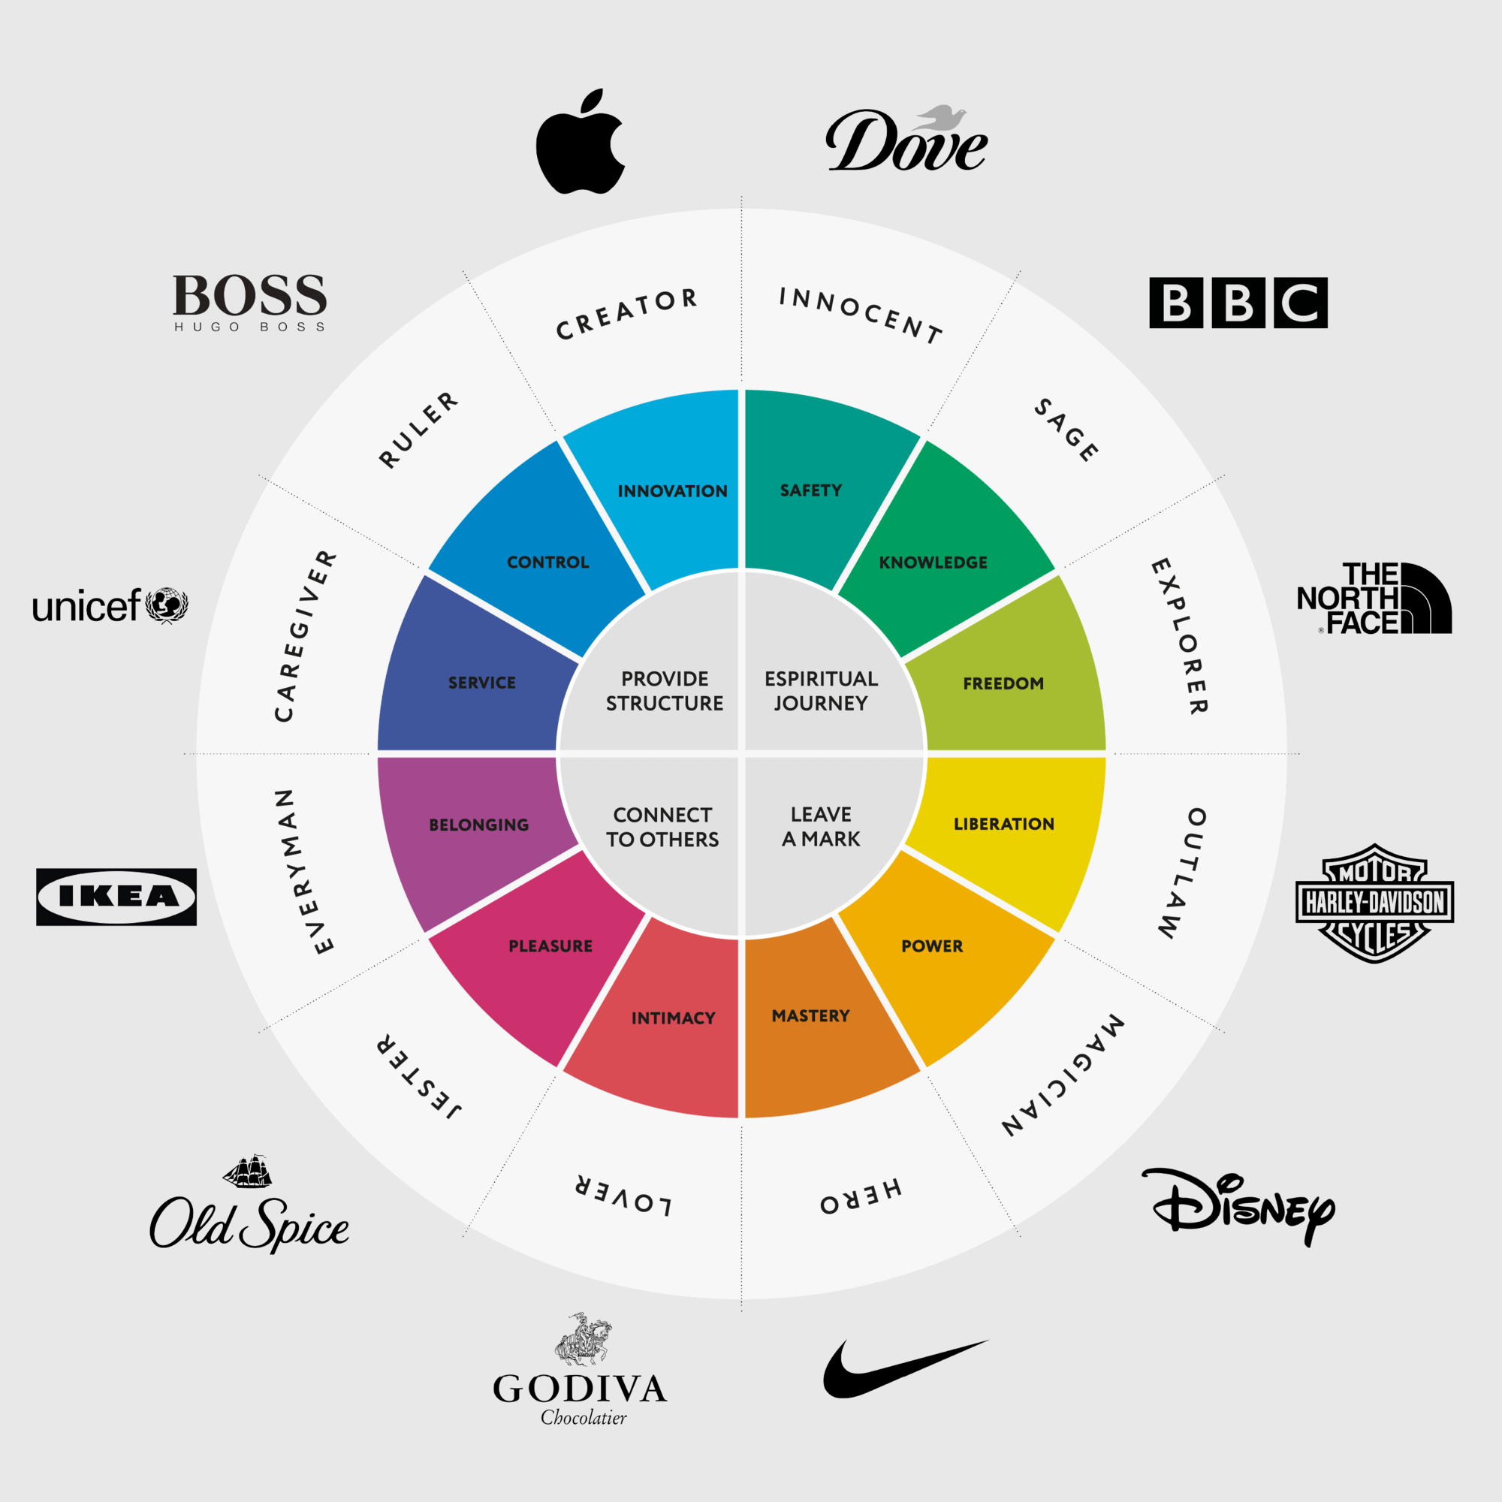
Examples of Brand Archetypes

Slide 24
Brand Archetypes
https://www.namely.design/blog/how-to-choose-your-brand-archetype
https://visionone.co.uk/brand-archetype-quiz/
https://www.drip.com/blog/brand-archetype-examples

Slide 25
Employer Brand – Links (Optional)
https://www.youtube.com/watch?v=TXq8Gvyg3eE
https://www.youtube.com/watch?v=z90JXJDh2OQ

Slide 26
Diagnosing and planning
Diagnosing involves evaluating the organization's current talent pool, identifying gaps and areas for improvement, and assessing the organization's overall talent needs. This can include analyzing employee skills and competencies, reviewing performance data, conducting employee surveys and assessments, and examining the organization's goals and objectives.
Planning involves developing strategies and programs to address the talent needs identified in the diagnostic stage. This can include creating recruitment and selection plans, developing employee training and development programs, designing succession planning initiatives, and developing performance management processes.

Slide 27
Competence, Capability, Capacity
Competence refers to an individual's knowledge, skills, and abilities (KSAs) in performing a particular job or task. It is a measure of how well an employee can perform the duties and responsibilities of their role. Competence is typically assessed through performance reviews, skills assessments, and other evaluation methods.
Capability is a broader concept that encompasses an individual's potential to learn and develop new KSAs. It refers to an employee's aptitude and willingness to acquire new skills and knowledge, adapt to changing circumstances, and take on new challenges. Capability is often assessed through training and development programs, coaching, and mentoring.
Capacity refers to the resources, both tangible and intangible, that an individual has available to them to perform their job or task. It includes factors such as time, energy, resources, and support systems. Capacity can be influenced by external factors such as workload, organizational culture, and work-life balance.

Slide 28
Competence:
A software developer has a high level of competence in Java and Python.
A sales representative has a high level of competence in building relationships with clients.
A customer service representative has a high level of competence in handling customer complaints.
Capability:
A marketing coordinator has the capability to learn and implement new digital marketing techniques.
A project manager has the capability to lead and motivate a team of diverse individuals towards a common goal.
A human resources professional has the capability to design and implement effective employee development and retention programs.
Capacity:
An accountant has the capacity to manage a large number of financial records efficiently.
A teacher has the capacity to create engaging lesson plans and grade assignments for students.
A nurse has the capacity to provide compassionate care to patients while managing a heavy workload.

Slide 29
Acquiring and Selecting
Acquiring talent can be done through various methods, such as posting job openings on job boards, reaching out to passive candidates through social media, and using recruitment agencies. It is important for organizations to have a clear understanding of the skills and competencies they require for a particular position, as well as a strong employer brand that can attract top talent.
Selecting talent involves assessing candidates' qualifications, skills, and experience, as well as their fit with the organization's culture and values. This process can include screening resumes, conducting interviews, administering tests and assessments, and checking references. It is important for organizations to use objective and consistent criteria when evaluating candidates to ensure that the selection process is fair and unbiased.

Slide 30
Acquisition in IHRM
Internal recruitment: This method involves promoting or transferring existing employees from within the company to positions in other countries or regions.
Employee referrals: Employee referrals are a cost-effective and reliable way to acquire talent in international HR management. This method involves encouraging existing employees to refer qualified candidates for open positions.
Job postings: Companies can use job postings to attract candidates for open positions in different countries or regions. These job postings can be posted on the company's website, job boards, or social media platforms.
Recruitment agencies: Recruitment agencies specialize in sourcing and identifying candidates for positions in different countries or regions. They can help companies find qualified candidates quickly and efficiently.
Campus recruiting: Campus recruiting involves visiting universities and colleges to attract and hire recent graduates for entry-level positions in different countries or regions.

Slide 31
Selection in IHRM
Interviews: This is a common selection method used in international HR management, where the company interviews candidates in person, over the phone, or via video conferencing.
Assessment centers: Assessment centers are commonly used to select candidates for senior positions in international HR management. This selection method involves evaluating candidates through various exercises, simulations, and group discussions.
Personality tests: Personality tests are used to assess candidates' personality traits and determine if they are a good fit for the company's culture and values.
Cognitive tests: Cognitive tests are used to assess candidates' problem-solving and critical-thinking abilities, which are essential for success in international HR management.
Language proficiency tests: Language proficiency tests are used to assess candidates' ability to communicate effectively in the language of the country or region they will be working in.
Reference checks: Reference checks are used to verify candidates' employment history and qualifications and to ensure that they are a good fit for the company.
Background checks: Background checks are used to verify candidates' criminal records, credit history, and other relevant information.

Slide 32
Types on Interviews
https://www.knowledgehut.com/blog/others/amazon-bar-raiser
Bar raiser interview
https://www.myconsultingcoach.com/case-interview
Case Interview

Slide 33
Case Study Example
Expanding a Software Company's Operations in Asia
ABC Software, a US-based software company, is planning to expand its operations in Asia by opening a new office in Singapore. The company is looking to hire 20 new employees for various positions, including software developers, project managers, and marketing specialists.
Your task is to develop an acquisition and selection strategy to hire the best talent for these positions, while ensuring compliance with the labor laws and cultural norms of Singapore.

Slide 34
Acquisition Strategy
a) Determine the company's target audience: Identify the key demographics and characteristics of the ideal candidates for each position, such as educational background, work experience, and language proficiency.
b) Identify recruitment channels: Determine the most effective recruitment channels to reach the target audience, such as online job boards, recruitment agencies, or university career fairs.
c) Develop a job posting: Create a job posting that accurately describes the job responsibilities, requirements, and qualifications. The job posting should also highlight the company's culture and values, and the benefits of working for ABC Software.
d) Determine compensation and benefits: Research the prevailing wage rates and benefits in Singapore to determine a competitive compensation package that will attract the best talent.

Slide 35
Selection Strategy
a) Develop selection criteria: Determine the key selection criteria for each position, such as technical skills, language proficiency, and cultural fit. Develop assessment tools such as interview questions, skills tests, and behavioral assessments that measure these criteria.
b) Train interviewers: Train interviewers on the selection criteria and assessment tools, and ensure that they are familiar with the cultural norms and labor laws in Singapore.
c) Conduct interviews: Conduct interviews with shortlisted candidates, either in person or via video conferencing. Use the assessment tools to evaluate each candidate's technical skills, language proficiency, and cultural fit.
d) Verify references and credentials: Verify each candidate's references and credentials to ensure that they have the necessary qualifications and experience for the position.
e) Make job offers: Make job offers to the selected candidates, and negotiate compensation and benefits packages as needed.

